Slide 1



Empowering Talent with Infosys Wingspan
Building Future-Ready Skills. Together.

Slide 2



Slide 3
What Is Apache Spark?
Apache Spark is a fast and general engine for large-scale data processing
§ Written in Scala
Functional programming language that runs in a JVM
§ Spark shell
Interactive—for learning or data exploration
Python or Scala
§ Spark applications
For large scale data process

Slide 4
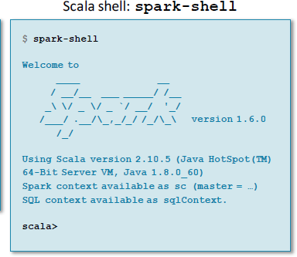
Spark Shell
§ The Spark shell provides interactive data exploration (REPL)

Slide 5
Spark Context
§ Every Spark application requires a Spark context
– The main entry point to the Spark API
§ The Spark shell provides a preconfigured Spark context called sc

Slide 6
RDD (Resilient Distributed Dataset)
RDD (Resilient Distributed Dataset)
Resilient: If data in memory is lost, it can be recreated
Distributed: Processed across the cluster
–Dataset: Initial data can come from a source such as a file, or it can be
created programmatically
§ RDDs are the fundamental unit of data in Spark
§ Most Spark programming consists of performing operations on RDDs

Slide 7
Creating an RDD
§ Three ways to create an RDD
From a file or set of files
From data in memory
From another RDD

Slide 8
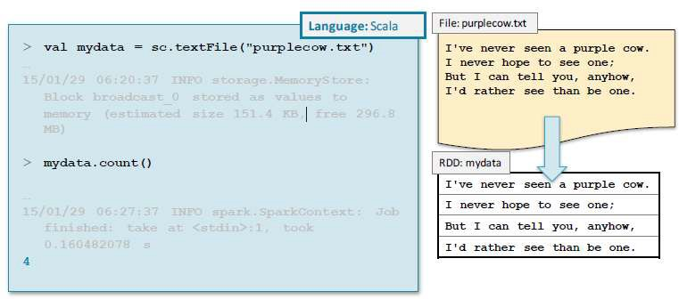
Example: A File-Based RDD

Slide 9


RDD Operations
§ Two broad types of RDD operations
– Actions return values
– Transformations define a new RDD based on the current one(s)

Slide 10
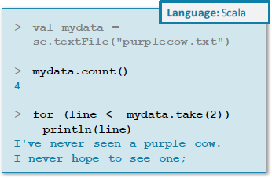
RDD Operations: Actions
§ Some common actions
–count() returns the number of elements
–take(n) returns an array of the first n elements
–collect() returns an array of all elements
–saveAsTextFile(dir) saves to text file(s)

Slide 11
RDD Operations: Transformations
Transformations create a new RDD from an existing one
§ RDDs are immutable
Data in an RDD is never changed
Transform in sequence to modify the data as needed
§ Two common transformations
–map(function)creates a new RDD by performing a function on each record in the base RDD
–filter(function)creates a new RDD by including or excluding each record in the base RDD according to a Boolean function

Slide 12
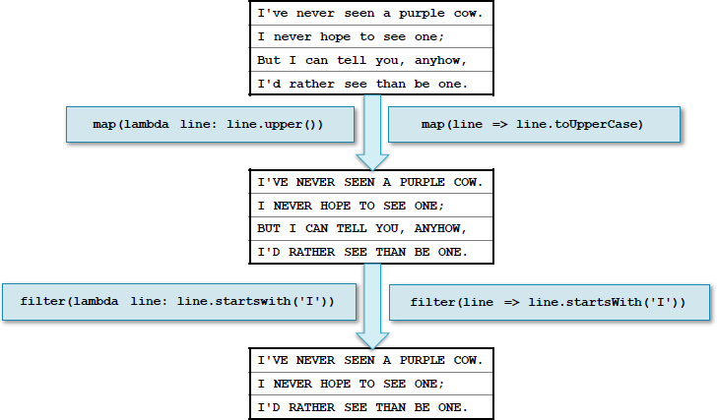
Example: map and filter
Transformations

Slide 13
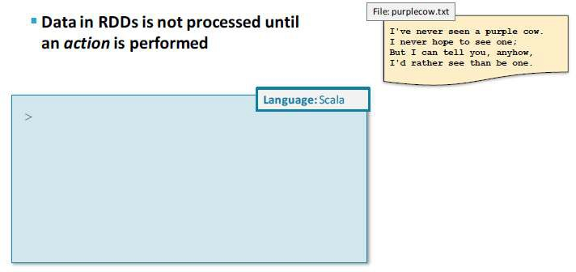
Lazy Execution (1)

Slide 14
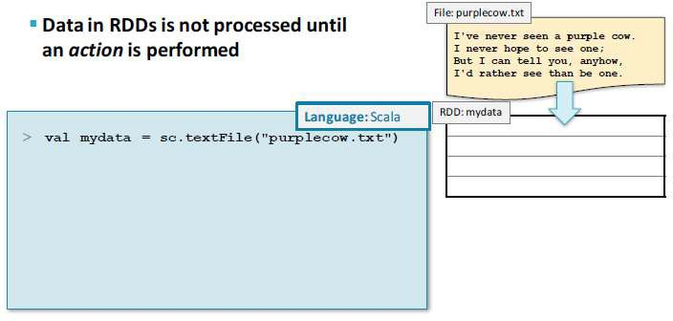
Lazy Execution (2)

Slide 15
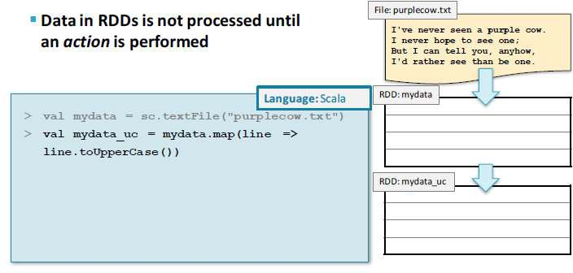
Lazy Execution (3)

Slide 16
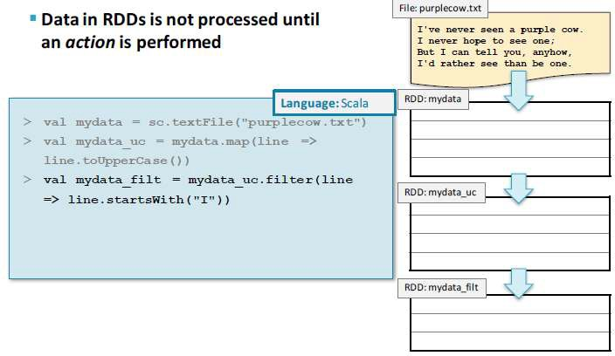
Lazy Execution (4)

Slide 17
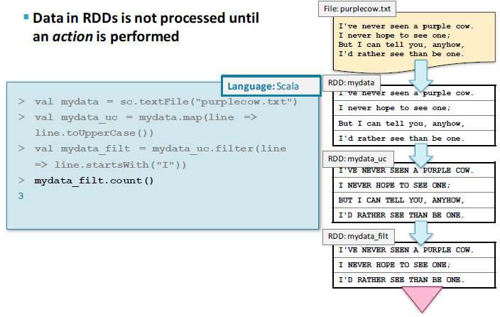
Lazy Execution (5)

Slide 18
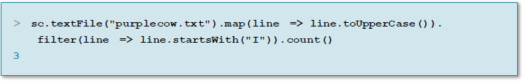
Chaining Transformations (Scala)
§ Transformations may be chained together

Slide 19

Working with RDDs

Slide 20
RDDs
RDDs can hold any serializable type of element
Primitive types such as integers, characters, and booleans
Sequence types such as strings, lists, arrays, tuples, and dicts (including nested data types)
Scala/Java Objects (if serializable)
Mixed types
§ Some RDDs are specialized and have additional functionality
Pair RDDs
RDDs consisting of key-value pairs
Double RDDs
RDDs consisting of numeric data

Slide 21
Creating RDDs from Collections
You can create RDDs from collections instead of files
–sc.parallelize(collection)
myData = ["Alice","Carlos","Frank","Barbara"]
myRdd = sc.parallelize(myData)
myRdd.take(2) ['Alice', 'Carlos']

Slide 22
Creating RDDs from Text Files (1)
For file-based RDDs, use SparkContext.textFile
Accepts a single file, a directory of files, a wildcard list of
files, or a comma-separated list of filesn Examples
–sc.textFile("myfile.txt")
–sc.textFile("mydata/")
–sc.textFile("mydata/*.log")
–sc.textFile("myfile1.txt,myfile2.txt")
Each line in each file is a separate record in the RDD
§ Files are referenced by absolute or relative URI
Absolute URI:
–file:/home/training/myfile.txt
–hdfs://nnhost/loudacre/myfile.txt

Slide 23
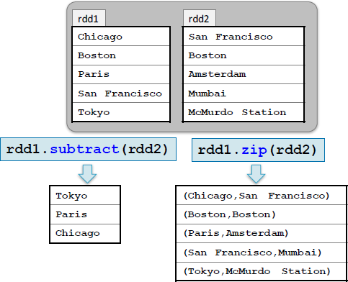
Examples: Multi-RDD Transformations (1)

Slide 24
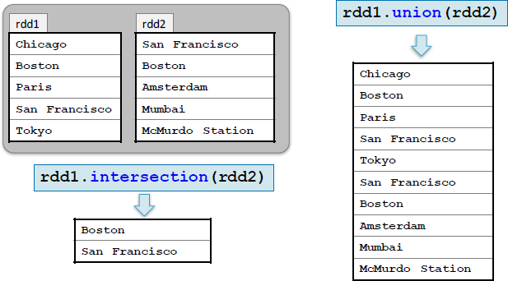
Examples: Multi-RDD Transformations (2)

Slide 25
Some Other General RDD Operations
Other RDD operations
–first returns the first element of the RDD
–foreach applies a function to each element in an RDD
–top(n) returns the largest n elements using natural ordering
§ Sampling operations
–sample creates a new RDD with a sampling of elements
–takeSample returns an array of sampled elements

Slide 26
Pair RDDs

Slide 27
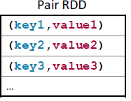
Pair RDDs
§ Pair RDDs are a special form of RDD
Each element must be a key-value pair (a two-element tuple)
Keys and values can be any type
§ Why?
Use with map-reduce algorithms
–Many additional functions are available for common data processing needs
Such as sorting, joining, grouping, and counting

Slide 28
Creating Pair RDDs
The first step in most workflows is to get the data into key/value form
–What should the RDD should be keyed on?
–What is the value?
§ Commonly used functions to create pair RDDs
–map
–flatMap / flatMapValues
–keyBy

Slide 29
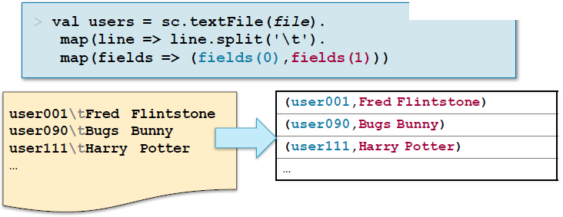
Example: A Simple Pair RDD
Example: Create a pair RDD from a tab-separated file

Slide 30
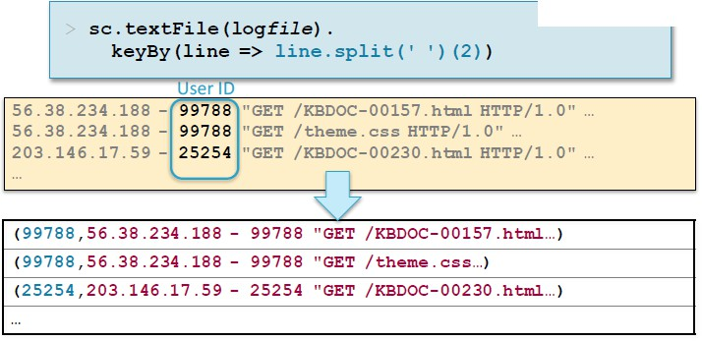
Example: Keying Web Logs by User ID

Slide 31
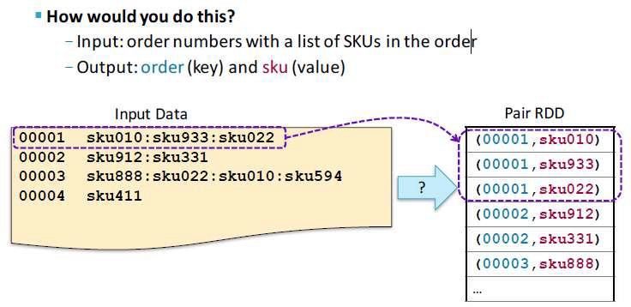
Mapping Single Rows to Multiple Pairs

Slide 32
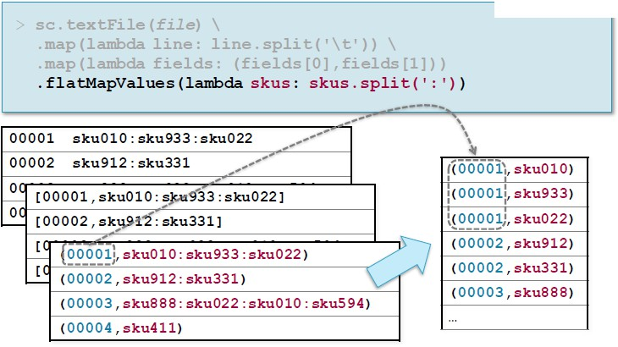
Answer : Mapping Single Rows to Multiple Pairs

Slide 33
Map-Reduce
§ Map-reduce is a common programming model
Easily applicable to distributed processing of large data sets
§ Hadoop MapReduce is the major implementation
Somewhat limited
Each job has one map phase, one reduce phase
Job output is saved to files
§ Spark implements map-reduce with much greater flexibility
–Map and reduce functions can be interspersed
Results can be stored in memory
Operations can easily be chained

Slide 34
Map-Reduce in Spark
§ Map-reduce in Spark works on pair RDDs
§ Map phase
–Operates on one record at a time
–“Maps” each record to zero or more new records
Examples: map, flatMap, filter, keyBy
§ Reduce phase
–Works on map output
Consolidates multiple records
Examples: reduceByKey, sortByKey, mean

Slide 35
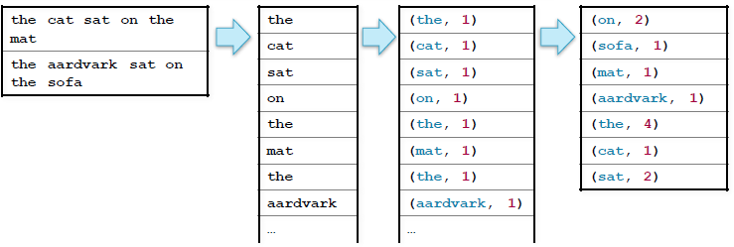
Example: Word Count

Slide 36
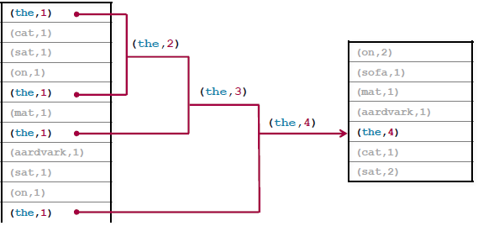
reduceByKey
The function passed to reduceByKey combines values from two keys
– Function must be binary

Slide 37
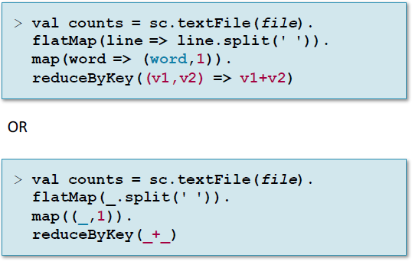

Slide 38
Pair RDD Operations
§ In addition to map and reduceByKey operations, Spark has several operations specific to pair RDDs
§ Examples
–countByKey returns a map with the count of occurrences of each key
–groupByKey groups all the values for each key in an RDD
–sortByKey sorts in ascending or descending order
–join returns an RDD containing all pairs with matching keys from two RDD

Slide 39
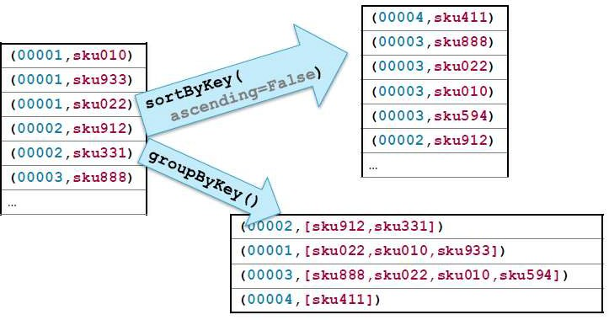
Example: Pair RDD Operations

Slide 40
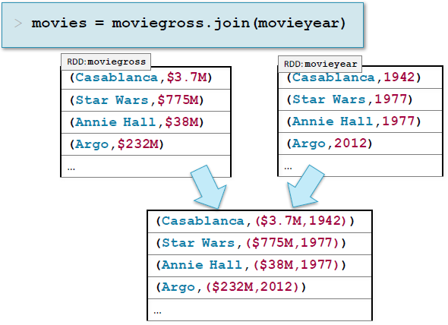
Example: Joining by Key

Slide 41
Other Pair Operations
§ Some other pair operations
–keys returns an RDD of just the keys, without the values
–values returns an RDD of just the values, without keys
–lookup(key) returns the value(s) for a key
–leftOuterJoin, rightOuterJoin , fullOuterJoin join two RDDs, including keys defined in the left, right or either RDD respectively
–mapValues, flatMapValues execute a function on just the values,
keeping the key the same

Slide 42
Writing and Running Apache Spark Applications

Slide 43
Spark Shell vs. Spark Applications
§ The Spark shell allows interactive exploration and manipulation of data
REPL using Python or Scala
§ Spark applications run as independent programs
Python, Scala, or Java
For jobs such as ETL processing, streaming, and so on

Slide 44
The Spark Context
§ Every Spark program needs a SparkContext object
The interactive shell creates one for you
§ In your own Spark application you create your own SparkContext object
Named sc by convention
Call sc.stop when program terminates

Slide 45
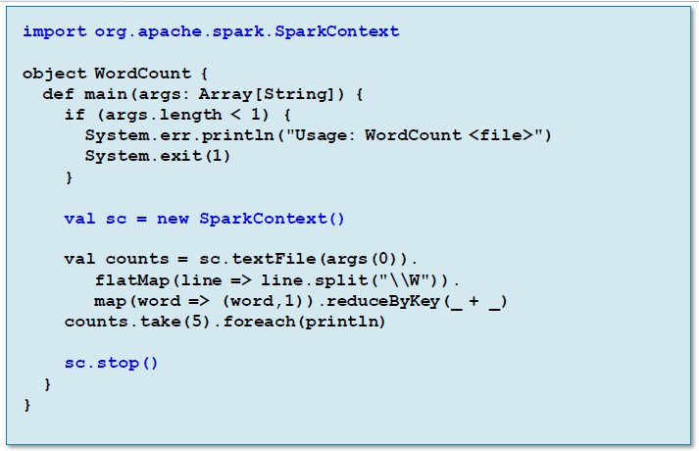
Example: Word Count

Slide 46
Building a Spark Application: Scala
§ Scala or Java Spark applications must be compiled and assembled into JAR
files
JAR file will be passed to worker nodes
§ Apache Maven is a popular build tool
For specific setting recommendations, see the Spark Programming
Guide
§ Build details will differ depending on
Version of Hadoop (HDFS)
–Deployment platform (YARN, Mesos, Spark Standalone)
§ Consider using an Integrated Development Environment (IDE)
IntelliJ or Eclipse are two popular examples
Can run Spark locally in a debugger

Slide 47

Running a Spark Application
The easiest way to run a Spark application is using the spark-
submit script

Slide 48
Spark Application Cluster Options
§ Spark can run
Locally
No distributed processing
Locally with multiple worker threads
On a cluster
§ Local mode is useful for development and testing
§ Production use is almost always on a cluster

Slide 49
Supported Cluster Resource Managers
§ Hadoop YARN
Included in CDH
–Most common for production sites
Allows sharing cluster resources with other applications
§ Spark Standalone
Included with Spark
Easy to install and run
Limited configurability and scalability
No security support
Useful for learning, testing, development, or small systems
§ Apache Mesos
First platform supported by Spark

Slide 50
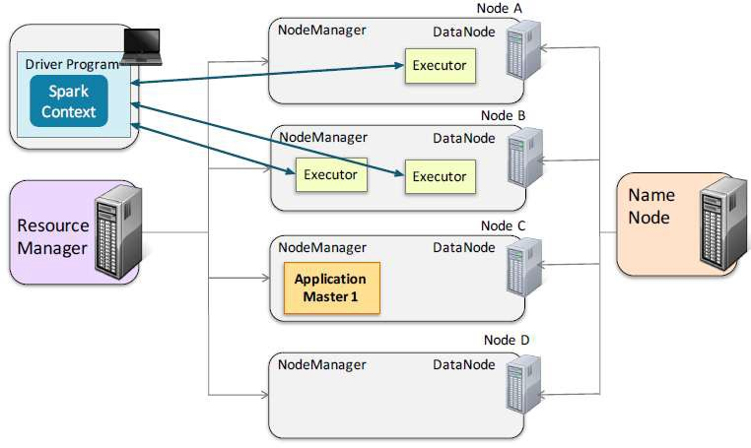
Spark Runs on YARN: Client Mode

Slide 51
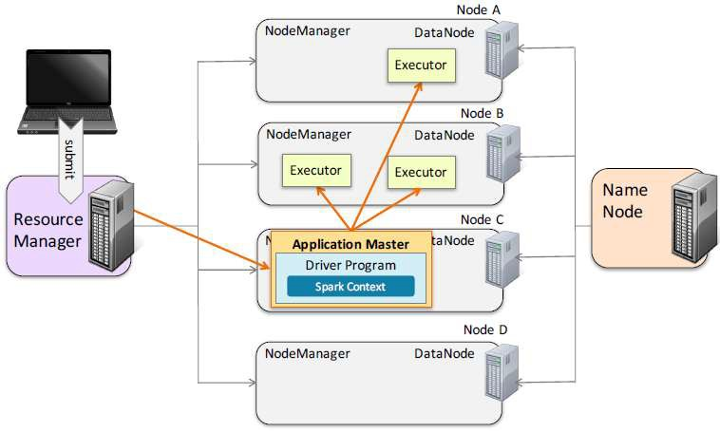
Spark Runs on YARN: Cluster Mode

Slide 52

Running a Spark Application Locally
Use spark-submit --master to specify cluster option
– Local options
–local[*] runs locally with as many threads as cores (default)
–local[n] runs locally with n threads
–local runs locally with a single thread

Slide 53

Running a Spark Application on a Cluster
§ Use spark-submit --master to specify cluster option
– Cluster options
–yarn-client
–yarn-cluster
–spark://masternode:port (Spark Standalone)
–mesos://masternode:port (Mesos)

Slide 54

Starting the Spark Shell on a Cluster
§ The Spark shell can also be run on a cluster
§ spark-shell has a --master option
–yarn (client mode only)
– Spark or Mesos cluster manager URL
–local[*] runs with as many threads as cores (default)
–local[n] runs locally with n worker threads
–local runs locally without distributed processing

Slide 55
Options when Submitting a Spark Application to a Cluster
§ Some other spark-submit options for clusters
--jars: Additional JAR files (Scala and Java only)
--py-files: Additional Python files (Python only)
--driver-java-options: Parameters to pass to the driver JVM
--executor-memory: Memory per executor (for example:
1000m,2g) (Default: 1g)
--packages: Maven coordinates of an external library to
include
§ Plus several YARN-specific options
--num-executors: Number of executors to start
--executor-cores: Number cores to allocate for each executor
--queue: YARN queue to submit the application to
§ Show all available options
-help

Slide 56
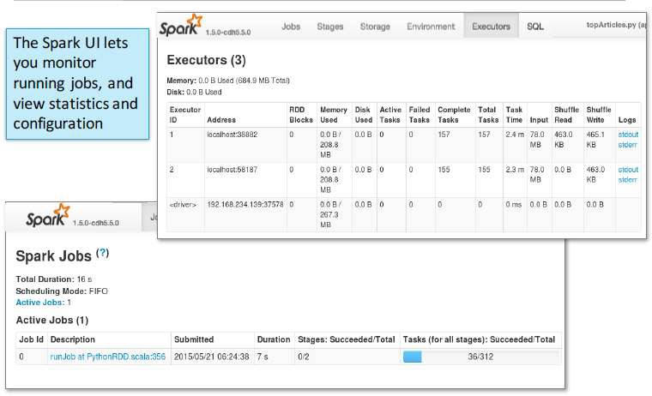
The Spark Application Web UI

Slide 57
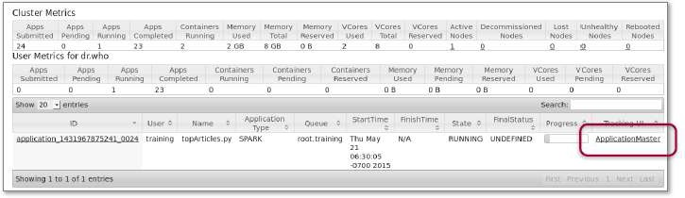
Accessing the Spark UI
§ The web UI is run by the Spark driver
–When running locally: http://localhost:4040
–When running on a cluster, access via the YARN UI

Slide 58
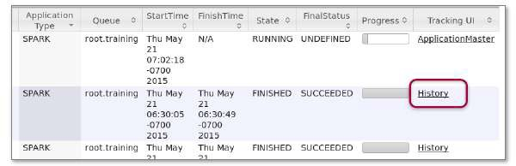
Viewing Spark Job History
§ Viewing Spark Job History
Spark UI is only available while the application is running
Use Spark History Server to view metrics for a completed application
Optional Spark component
§ Accessing the History Server
For local jobs, access by URL
Example: localhost:18080
For YARN Jobs, click History link in YARN UI

Slide 59
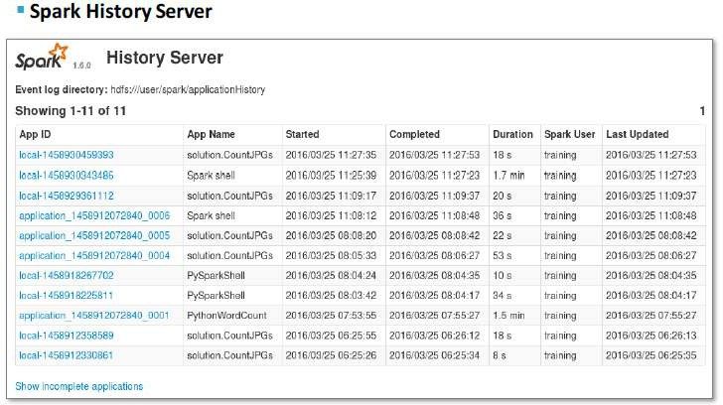
Viewing Spark Job History

Slide 60
Configuring Apache Spark Applications

Slide 61
Spark Application Configuration
§ Spark provides numerous properties for configuring your application
§ Some example properties
–spark.master
–spark.app.name
–spark.local.dir: Where to store local files such as shuffle output (default /tmp)
–spark.ui.port: Port to run the Spark Application UI (default
4040)
–spark.executor.memory: How much memory to allocate to each
Executor (default 1g)
–spark.driver.memory: How much memory to allocate to the driver in client mode (default 1g)

Slide 62
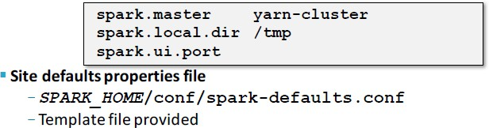
Declarative Configuration Options
§ spark-submit script
Examples:
–spark-submit --driver-memory 500M
–spark-submit --conf spark.executor.cores=4
§ Properties file
Tab- or space-separated list of properties and values
Load with spark-submit --properties-file filename

Slide 63
Setting Configuration Properties Programmatically
§ Spark configuration settings are part of the Spark context
§ Configure using a SparkConf object
§ Some example set functions
–setAppName(name)
–setMaster(master)
–set(property-name, value)
§ set functions return a SparkConf object to support chaining

Slide 64
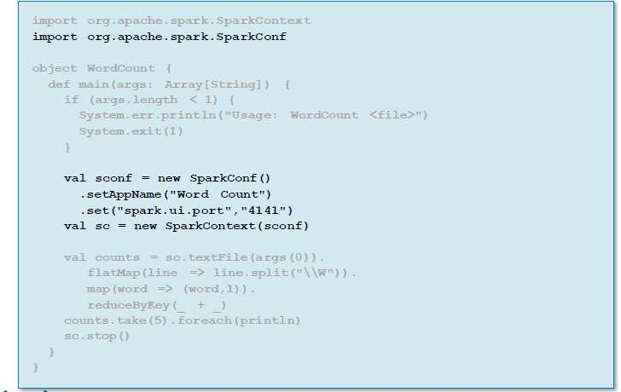
SparkConf Example

Slide 65
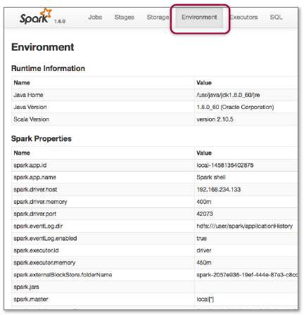
Viewing Spark Properties
§ You can view the Spark property settings in the Spark Application UI
– Environment tab

Slide 66
Spark Logging
§ Spark uses Apache Log4j for logging
Allows for controlling logging at runtime using a properties
file
Enable or disable logging, set logging levels, select output destination
For more info see http://logging.apache.org/log4j/1.2/
§ Log4j provides several logging levels
–TRACE
–DEBUG
–INFO
–WARN
–ERROR
–FATAL
–OFF

Slide 67
Spark Log Files
§ Log file locations depend on your cluster management platform
§ YARN
If log aggregation is off, logs are stored locally on each worker node
If log aggregation is on, logs are stored in HDFS
Default /var/log/hadoop-yarn
Access with yarn logs command or YARN Resource Manager UI

Slide 68
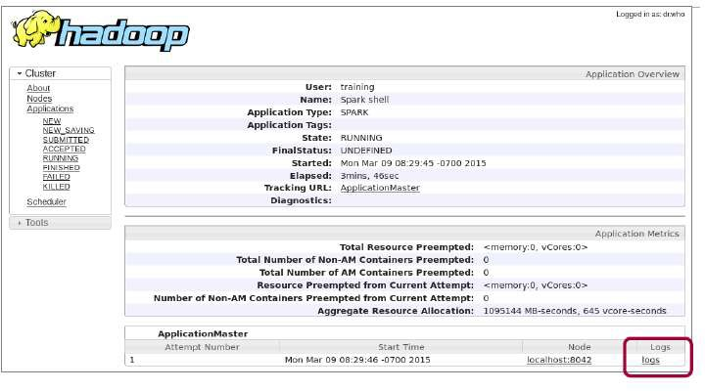
Spark Log Files

Slide 69
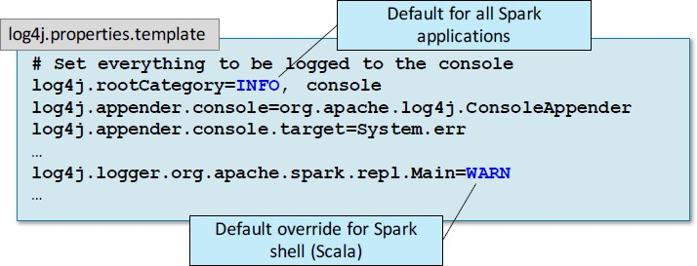
Configuring Spark Logging
§ Logging levels can be set for the cluster, for individual applications, or even
for specific components or subsystems
§ Default for machine: SPARK_HOME/conf/log4j.properties*
– Start by copying log4j.properties.template

Slide 70

Configuring Spark Logging
§ Logging in the Spark shell can be configured interactively
– The setLogLevel method sets the logging level temporarily

Slide 71
Parallel Processing in Apache Spark

Slide 72
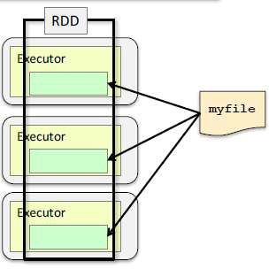
File Partitioning: Single Files
§ Partitions from single files
Partitions based on size
You can optionally specify a minimum number of partitions textFile(file, minPartitions)
Default is two when running on a cluster
Default is one when running
locally with a single thread
–More partitions = more parallelization

Slide 73
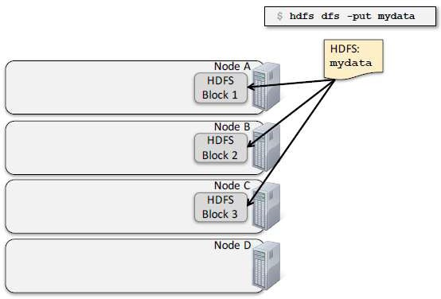
HDFS and Data Locality

Slide 74
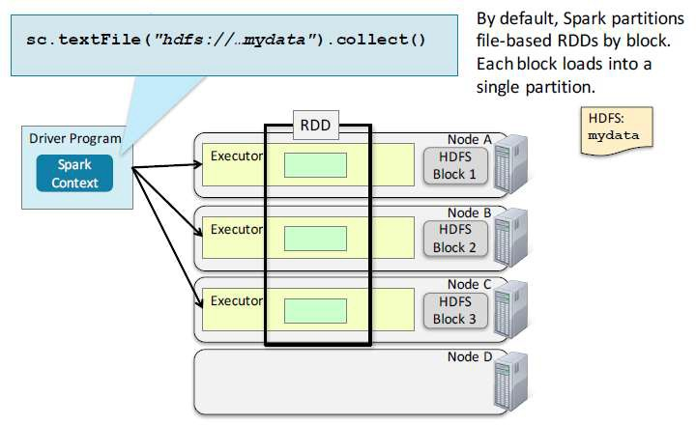
HDFS and Data Locality

Slide 75
Parallel Operations on Partitions
§ RDD operations are executed in parallel on each partition –When possible, tasks execute on the worker nodes where the data is in stored
§ Some operations preserve partitioning
Such as map, flatMap, or filter
§ Some operations repartition
Such as reduceByKey, sortByKey, join, or groupByKey

Slide 76
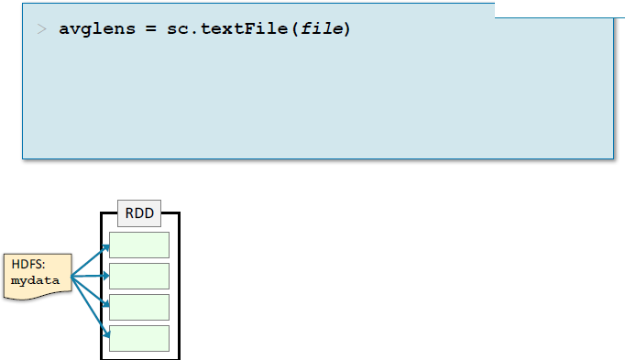
Example: Average Word Length by Letter (1)

Slide 77
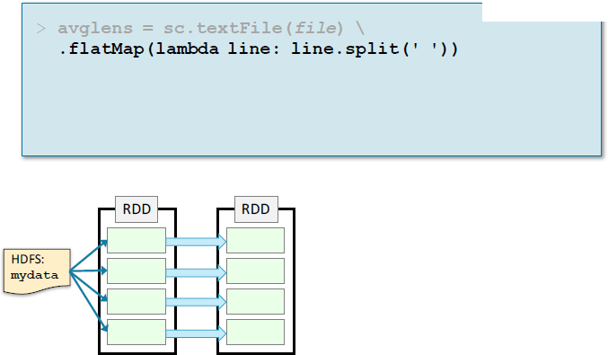
Example: Average Word Length by Letter (2)

Slide 78
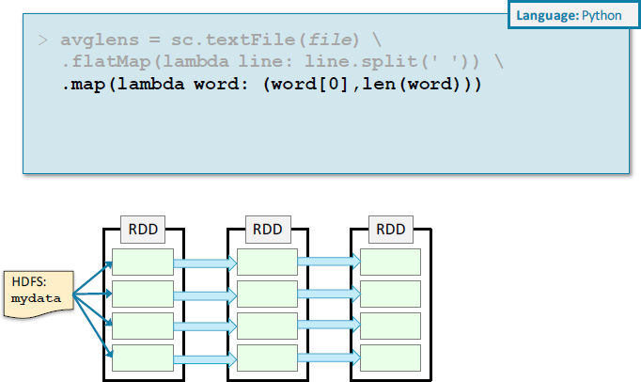
Example: Average Word Length by Letter (3)

Slide 79
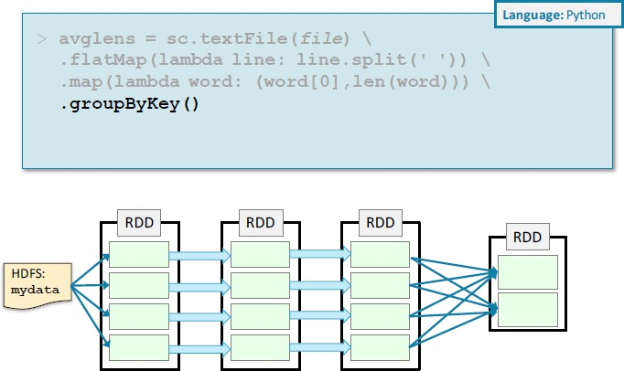
Example: Average Word Length by Letter (4)

Slide 80
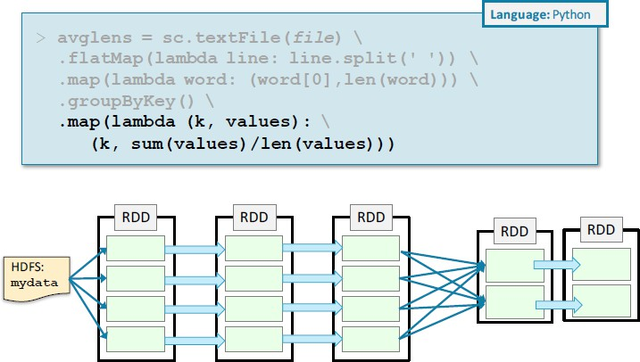
Example: Average Word Length by Letter (5)

Slide 81
Stages
§ Operations that can run on the same partition are executed in stages
§ Tasks within a stage are pipelined together
§ Developers should be aware of stages to improve performance

Slide 82
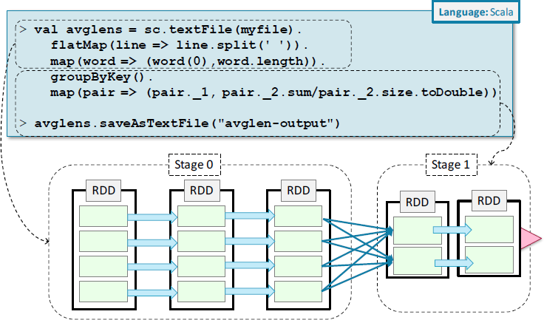
Spark Execution: Stages

Slide 83
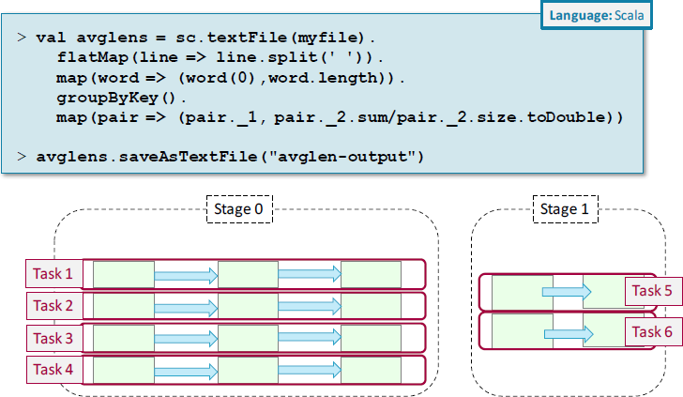
Spark Execution: Stages

Slide 84
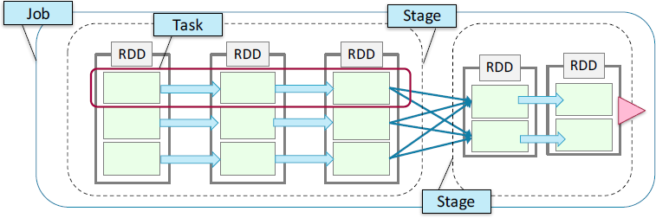
Summary of Spark Terminology
§ Job—a set of tasks executed as a result of an action
§ Stage—a set of tasks in a job that can be executed in parallel
§ Task—an individual unit of work sent to one executor
§ Application—the set of jobs managed by a single driver

Slide 85
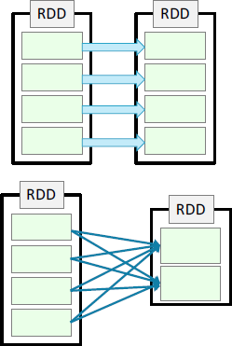
How Spark Calculates Stages
§ Spark constructs a DAG (Directed Acyclic Graph) of RDD dependencies
§ Narrowdependencies
Each partition in the child RDD depends on just one partition of the parent RDD
No shuffle required between executors
Can be collapsed into a single stage
Examples: map, filter, and union
§ Wide (or shuffle) dependencies
Child partitions depend on multiple partitions in the parent RDD
Defines a new stage
Examples: reduceByKey, join

Slide 86


Controlling the Level of Parallelism
§ Wide operations (such as reduceByKey) partition resulting RDDs
–More partitions = more parallel tasks
Cluster will be under-utilized if there are too few partitions
§ You can control how many partitions
Optional numPartitionsparameter in function call

Slide 87
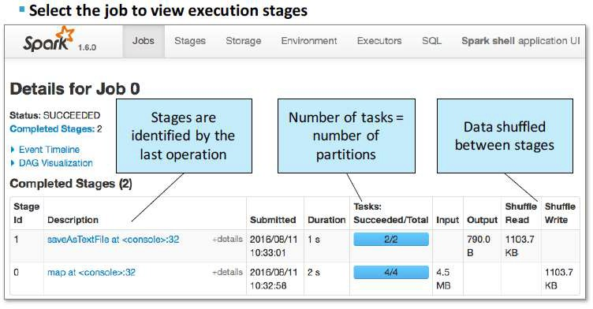
Viewing Stages in the Spark Application UI

Slide 88
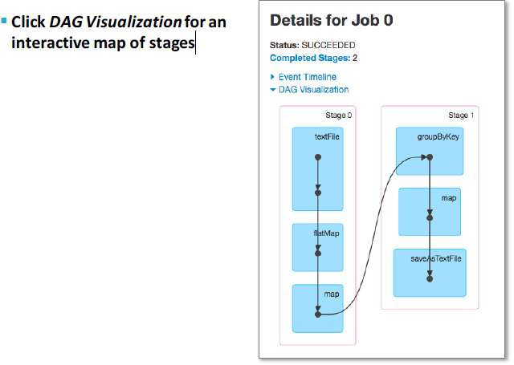
Viewing Stages in the Spark Application UI

Slide 89
RDD Persistence

Slide 90
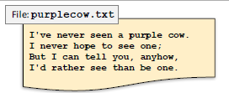
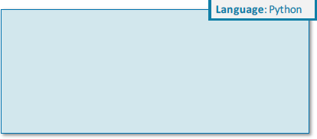
Lineage Example (1)
§ Each transformation operation
creates a new child RDD

Slide 91


Lineage Example (2)
§ Each transformation operation
creates a new child RDD

Slide 92


Lineage Example (3)
§ Each transformation operation
creates a new child RDD

Slide 93

Lineage Example (4)
§ Spark keeps track of the parent RDD
for each new RDD
§ Child RDDs depend on their parents

Slide 94

Lineage Example (4)

Slide 95


RDD Persistence
§ Persisting an RDD saves the data (in memory, by default)

Slide 96


RDD Persistence
§ Persisting an RDD saves the data (in memory, by default)

Slide 97


RDD Persistence
Subsequent operations use saved data

Slide 98


RDD Persistence
Subsequent operations use saved data

Slide 99
Memory Persistence
§ In-memory persistence is a suggestion to Spark
If not enough memory is available, persisted partitions
will be cleared from memory
Least recently used partitions cleared first
Transformations will be re-executed using the lineage
when needed

Slide 100
Persistence Levels
§ By default, the persist method stores data in memory only
§ The persist method offers other options called
storage levels
§ Storage levels let you control
Storage location (memory or disk)
Format in memory
Partition replication

Slide 101

Persistence Levels: Storage Location
§ Storage location—where is the data stored?
–MEMORY_ONLY: Store data in memory if it fits
–MEMORY_AND_DISK: Store partitions on disk if they do not fit in memory
– Called spilling
–DISK_ONLY: Store all partitions on disk

Slide 102
Persistence Levels: Partition Replication
§ Replication—store partitions on two nodes
–DISK_ONLY_2
–MEMORY_AND_DISK_2
–MEMORY_ONLY_2
–MEMORY_AND_DISK_SER_2
–MEMORY_ONLY_SER_2
– You can also define custom storage levels

Slide 103
Default Persistence Levels
§ The storageLevel parameter for the persist() operation is optional
If no storage level is specified, the default value depends on the language
Scala default: MEMORY_ONLY
§ cache() is a synonym for persist() with no storage level specified

Slide 104
When and Where to Persist
§ When should you persist a dataset?
–When a dataset is likely to be re-used
Such as in iterative algorithms and machine learning
§ How to choose a persistence level
–Memory only—choose when possible, best performance
Save space by saving as serialized objects in memory if necessary
Disk—choose when recomputation is more expensive than disk read
Such as with expensive functions or filtering large datasets
Replication—choose when recomputation is more expensive than memory

Slide 105
Changing Persistence Options
§ To stop persisting and remove from memory and disk
–rdd.unpersist()
§ To change an RDD to a different persistence level
– Unpersist first

Slide 106
DataFrames and Apache Spark SQL

Slide 107
What is Spark SQL?
§ What is Spark SQL?
Spark module for structured data processing
Replaces Shark (a prior Spark module, now deprecated)
Built on top of core Spark
§ What does Spark SQL provide?
The DataFrame API—a library for working with data as tables
Defines DataFrames containing rows and columns
DataFrames are the focus of this chapter!
Catalyst Optimizer—an extensible optimization framework
A SQL engine and command line interface

Slide 108
SQL Context
§ The main Spark SQL entry point is a SQL context object
Requires a SparkContext object
The SQL context in Spark SQL is similar to Spark context in core Spark
§ There are two implementations
–SQLContext
Basic implementation
–HiveContext
Reads and writes Hive/HCatalog tables directly
Supports full HiveQL language
Requires the Spark application be linked with Hive libraries
Cloudera recommends using HiveContext

Slide 109

Creating a SQL Context
§ The Spark shell creates a HiveContext instance automatically
Call sqlContext
You will need to create one when writing a Spark application
Having multiple SQL context objects is allowed
§ A SQL context object is created based on the Spark context

Slide 110
DataFrames
§ DataFrames are the main abstraction in Spark SQL
Analogous to RDDs in core Spark
A distributed collection of structured data organized into named columns
Built on a base RDD containing Row objects

Slide 111
Creating a DataFrame from a Data Source
§ sqlContext.read returns a DataFrameReader object
§ DataFrameReader provides the functionality to load data into a DataFrame
§ Convenience functions
–json(filename)
–parquet(filename)
–orc(filename)
–table(hive-tablename)
–jdbc(url,table,options)

Slide 112

Example: Creating a DataFrame from a JSON File

Slide 113

Example: Creating a DataFrame from a Hive/Impala Table

Slide 114

Loading from a Data Source Manually
§ You can specify settings for the DataFrameReader
–format: Specify a data source type
–option: A key/value setting for the underlying data source
–schema: Specify a schema instead of inferring from the data source
§ Then call the generic base function load

Slide 115
Data Sources
§ Spark SQL 1.6 built-in data source types
–table
–json
–parquet
–jdbc
–orc
§ You can also use third party data source libraries, such as
Avro (included in CDH)
HBase
CSV
–MySQL
and more being added all the time

Slide 116
DataFrame Basic Operations
§ Basic operations deal with DataFrame metadata (rather than its data)
§ Some examples
–schema returns a schema object describing the data
–printSchema displays the schema as a visual tree
–cache / persist persists the DataFrame to disk or memory
–columns returns an array containing the names of the columns
–dtypes returns an array of (column name,type) pairs
–explain prints debug information about the DataFrame to the
console

Slide 117

DataFrame Basic Operations

Slide 118

DataFrame Actions
§ Some DataFrame actions
–collect returns all rows as an array of Row objects
–take(n) returns the first n rows as an array of Row objects
–count returns the number of rows
–show(n)displays the first n rows (default=20)

Slide 119
DataFrame Queries
§ DataFrame query methods return new DataFrames
Queries can be chained like transformations
§ Some query methods
–distinct returns a new DataFrame with distinct elements of this DF
–join joins this DataFrame with a second DataFrame
Variants for inside, outside, left, and right joins
–limit returns a new DataFrame with the first n rows of this DF
–select returns a new DataFrame with data from one or more columns of the base DataFrame
–where returns a new DataFrame with rows meeting specified query criteria (alias for filter)

Slide 120

DataFrame Query Strings

Slide 121



Querying DataFrames using Columns
§ Columns can be referenced in multiple ways

Slide 122

Joining DataFrames
§ A basic inner join when join column is in both DataFrames

Slide 123

Joining DataFrames

Slide 124

SQL Queries
§ When using HiveContext, you can query Hive/Impala tables using HiveQL
– Returns a DataFrame

Slide 125

Saving DataFrames
§ Data in DataFrames can be saved to a data source
§ Use DataFrame.write to create a DataFrameWriter
§ DataFrameWriter provides convenience functions to externally save the data represented by a DataFrame
–jdbc inserts into a new or existing table in a database
–json saves as a JSON file
–parquet saves as a Parquet file
–orc saves as an ORC file
–text saves as a text file (string data in a single column only)
–saveAsTable saves as a Hive/Impala table (HiveContext only)

Slide 126

Options for Saving DataFrames
§ DataFrameWriter option methods
–format specifies a data source type
–mode determines the behavior if file or table already exists:
overwrite, append, ignore or error (default is error)
–partitionBy stores data in partitioned directories in the form
column=value (as with Hive/Impala partitioning)
–options specifies properties for the target data source
–save is the generic base function to write the data

Slide 127

DataFrames and RDDs
§ DataFrames are built on RDDs
Base RDDs contain Rowobjects
Use rdd to get the underlying RDD

Slide 128
DataFrames and RDDs
§ Row RDDs have all the standard Spark actions and transformations
Actions: collect, take, count, and so on
Transformations: map, flatMap, filter, and so on
§ Row RDDs can be transformed into pair RDDs to use map-
reduce methods
§ DataFrames also provide convenience methods (such as map, flatMap, and foreach)for converting to RDDs

Slide 129
Working with Row Objects
Use Array-like syntax to return values with type Any
–row(n) returns element in the nth column
–row.fieldIndex("age")returns index of the age column
Use methods to get correctly typed values
–row.getAs[Long]("age")
Use type-specific get methods to return typed values
–row.getString(n) returns nth column as a string
–row.getInt(n) returns nth column as an integer
And so on

Slide 130

Example: Extracting Data from Row
Objects

Slide 131

Converting RDDs to DataFrames
§ You can also create a DF from an RDD using createDataFrame

Slide 132
Apache Spark Streaming

Slide 133
What Is Spark Streaming?
An extension of core Spark
§ Provides real-time processing of stream data
§ Versions 1.3 and later support Java, Scala, and Python
– Prior versions did not support Python

Slide 134
Spark Streaming Features
§ Second-scale latencies
§ Scalability and efficient fault tolerance
§ “Once and only once” processing
§ Integrates batch and real-time processing
§ Easy to develop
–Uses Spark’s high-level API

Slide 135

Spark Streaming Overview
§ Divide up data stream into batches of n seconds
– Called a DStream (Discretized Stream)
§ Process each batch in Spark as an RDD
§ Return results of RDD operations in batches

Slide 136

Example: Streaming Request Count

Slide 137

DStreams
§ A DStream is a sequence of RDDs representing a data stream

Slide 138

Streaming Example Output (1)

Slide 139

Streaming Example Output (1)

Slide 140
DStream Data Sources
§ DStreams are defined for a given input stream (such as a Unix socket)
Created by the Streaming context
ssc.socketTextStream(hostname, port)
Similar to how RDDs are created by the Spark context
§ Out-of-the-box data sources
Network
Sockets
Services such as Flume, Akka Actors, Kafka, ZeroMQ, or Twitter
Files
–Monitors an HDFS directory for new content

Slide 141
DStream Operations
§ DStream operations are applied to every RDD in the stream
Executed once per duration
§ Two types of DStream operations
Transformations
Create a new DStream from an existing one
Output operations
–Write data (for example, to a file system, database, or console)
Similar to RDD actions

Slide 142

DStream Transformations
§ Many RDD transformations are also available on DStreams
Regular transformations such as map, flatMap, filter
Pair transformations such as reduceByKey, groupByKey, join
§ What if you want to do something else?
–transform(function)
Creates a new DStream by executing function on RDDs in the current DStream

Slide 143

DStream Transformations

Slide 144
DStream Output Operations
§ Console output
–print (Scala) / pprint (Python) prints out the first 10 elements of
each RDD
Optionally pass an integer to print another number of elements
§ File output
–saveAsTextFiles saves data as text
–saveAsObjectFiles saves as serialized object files (SequenceFiles)
§ Executing other functions
–foreachRDD(function)performs a function on each RDD in the DStream
Function input parameters
The RDD on which to perform the function
The time stamp of the RDD (optional)

Slide 145

Saving DStream Results as Files

Slide 146
Building and Running Spark Streaming Applications
§ Building Spark Streaming applications
Link with the main Spark Streaming library (included with Spark)
Link with additional Spark Streaming libraries if necessary, for
example, Kafka, Flume, Twitter
§ Running Spark Streaming applications
Use at least two threads if running locally
Adding operations after the Streaming context has been started is unsupported
Stopping and restarting the Streaming context is unsupported

Slide 147

Using Spark Streaming with Spark Shell
§ Spark Streaming is designed for batch applications, not interactive use
§ The Spark shell can be used for limited testing
Not intended for production use!
Be sure to run the shell on a cluster with at least 2 cores, or locally with at least 2 threads
Using Spark Streaming with Spark Shell

Slide 148

The Spark Streaming Application UI

Slide 149

Sliding Window Operations
§ Regular DStream operations execute for each RDD based on SSC duration
§ “Window” operations span RDDs over a given duration
– For example reduceByKeyAndWindow, countByWindow

Slide 150

Sliding Window Operations
§ By default, window operations will execute with an “interval” the same as
the SSC duration
– For two-second batch duration, window will “slide” every two seconds

Slide 151

Sliding Window Operations
§ You can specify a different slide duration (must be a multiple of the SSC duration)

Slide 152

Scala Example: Count and Sort User Requests by Window

Slide 153
Spark Streaming Data Sources
§ Basic data sources
Network socket
Text file
§ Advanced data sources
Kafka
Flume
Twitter
ZeroMQ
Kinesis
–MQTT
and more coming in the future…
§ To use advanced data sources, download (if necessary) and link to the required library

Slide 154

Receiver-Based Replication
§ Spark Streaming RDD replication is enabled by default
– Data is copied to another node as it received

Slide 155

Receiver-Based Fault Tolerance
§ If the receiver fails, Spark will restart it on a different executor
– Potential for brief loss of incoming data

Slide 156
Kafka Direct Integration
§ Direct (also called receiverless)
Support for efficient zero-loss
Support for exactly-once semantics
Introduced in Spark 1.3 (Scala and Java only)
Python support in Spark 1.5

Slide 157

Kafka Direct Integration
§ Direct (also called receiverless)
Consumes messages in parallel
Automatically assigns each topic partition to an RDD
partition

Slide 158

Scala Example: Direct Kafka Integration

Slide 159

Scala Example: Direct Kafka Integration

Slide 160
Accumulator variable
Accumulators are variables that are only “added” to through an associative and commutative operation and can therefore be efficiently supported in parallel.
They can be used to implement counters (as in MapReduce) or sums
val accum = sc.accumulator(0)
sc.parallelize(Array(1, 2, 3, 4)).foreach(x => accum += x)
accum.value

Slide 161

Broadcast Variable
A broadcast variable is a read-only variable cached once in each executor that can be shared among tasks.
It cannot be modified by the executor.
The goal of broadcast variables is to increase performance by not copying a local dataset to each task that needs it and leveraging a broadcast version of it.

Slide 162
Broadcast Variable
val pws = Map("Apache Spark" -> "http://spark.apache.org/",
"Scala" -> "http://www.scala-lang.org/")/)
val websites = sc.parallelize(Seq("Apache Spark", "Scala")).map(pws).collect
// with Broadcast
val pwsB = sc.broadcast(pws)
val websites = sc.parallelize(Seq("Apache Spark", "Scala")).map(pwsB.value).collect

Slide 163
partitionBy
This function operates on RDDs where every element is of the form list(K, V) or c(K, V).
For each element of this RDD, the partitioner is used to compute a hash function and the RDD is partitioned using this hash value.
partitionBy(rdd, numPartitions, ...)

Slide 164
Check pointing
When a worker node dies, any intermediate data stored on the executor has to be re-computed
When the lineage gets too long, there is a possibility of a stack overflow.
Spark provides a mechanism to mitigate these issues: checkpointing.
sc.setCheckpointDir("hdfs://somedir/") rdd = sc.textFile("/path/to/file.txt") while x in range(<large number>) rdd.map(…)
if x % 5 == 0 rdd.checkpoint()
rdd.saveAsTextFile("/path/to/output.txt")

Slide 165

Executor Optimization
When submitting an application, we tell the context
--executor-memory
--num-executors
--executor-cores

Slide 166
Thank you
© 2026 Infosys Limited, Bangalore, India. All Rights Reserved. Infosys believes the information in this document is accurate as of its publication date; such information is subject to change without notice. Infosys acknowledges the proprietary rights of other companies to the trademarks, product names and such other intellectual property rights mentioned in this document. Except as expressly permitted, neither this documentation nor any part of it may be reproduced, stored in a retrieval system, or transmitted in any form or by any means, electronic, mechanical, printing, photocopying, recording or otherwise, without the prior permission of Infosys Limited and/ or any named intellectual property rights holders under this document.

